Slide 1
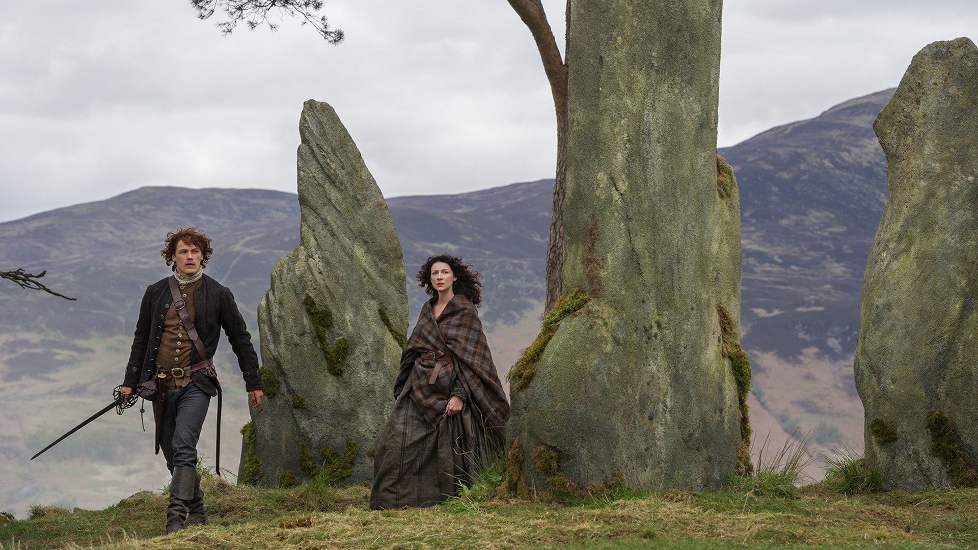
Riddles of Menhir
Python Text Game
based on the Netflix series Outlander
14 November 2018
Lani L. Mateo
lmateo2018@student.hult.edu

Slide 2

Riddles of Menhir Game Map
Start
Global variables
name
country
datetime_player
While, Nested conditional
Stone 1
The Enigma
of Spacetime
0.67
Stone 2
The Eye of Ra
Stone 3
The Way Out
0.50
0.67
1.00
Success
Starting Path
Conditional
0.50
0.33
0.33
0.00
Fail
2

